Slide 1
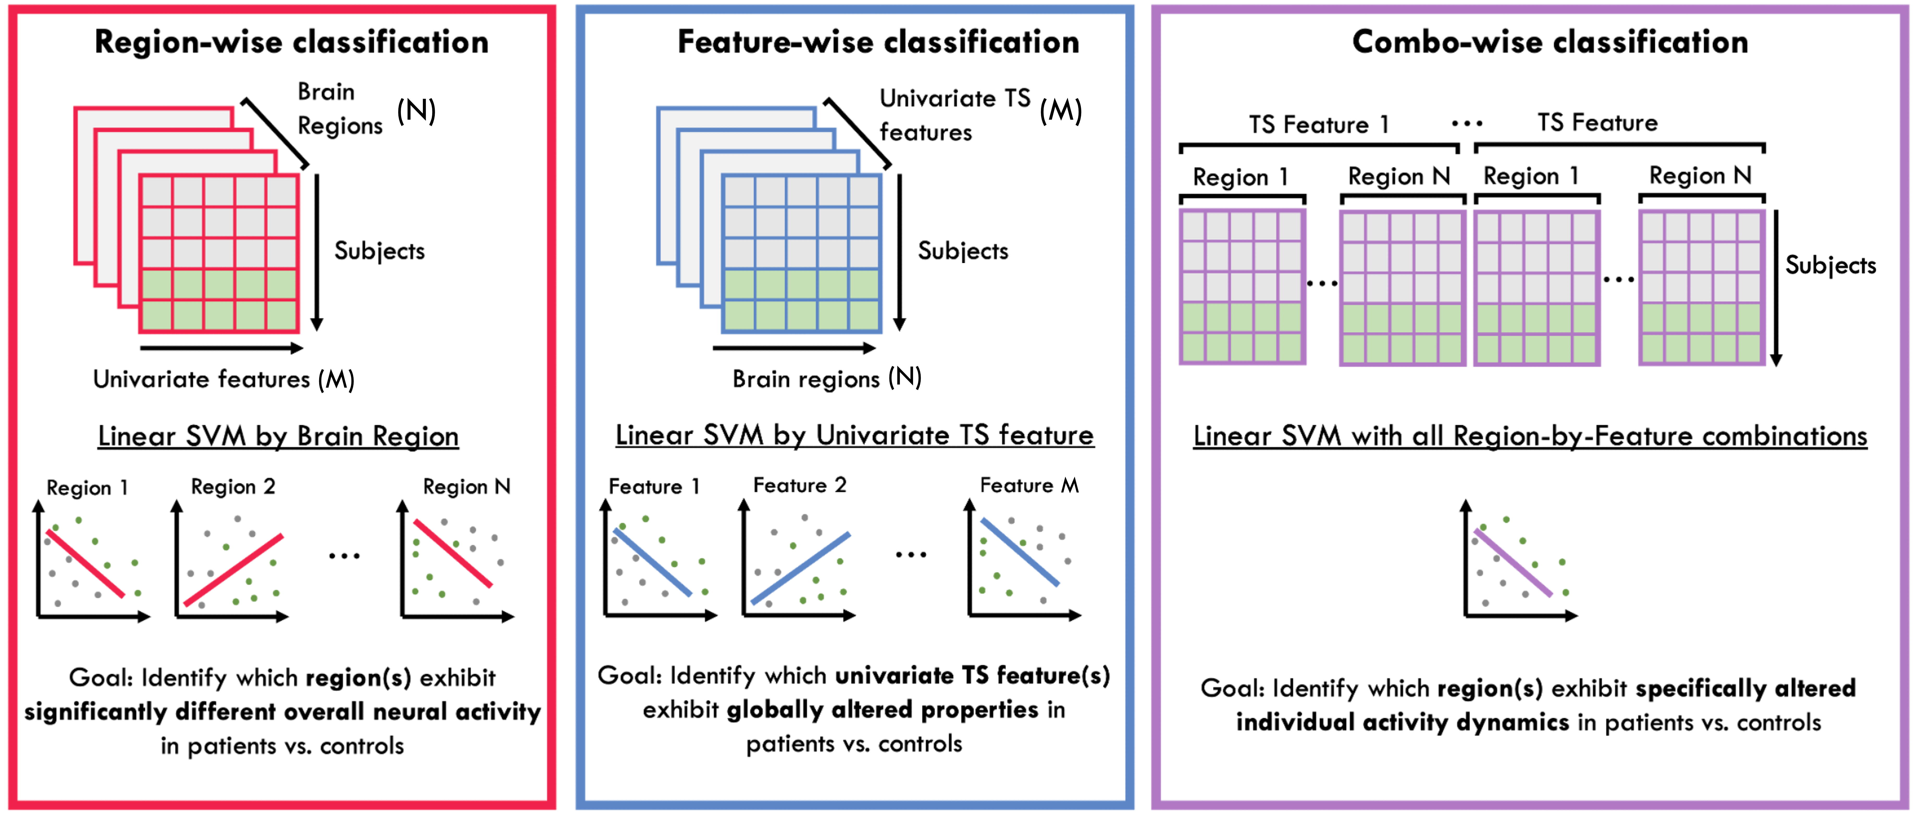
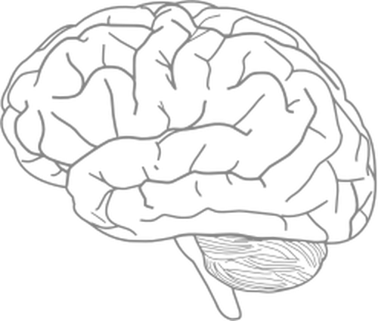
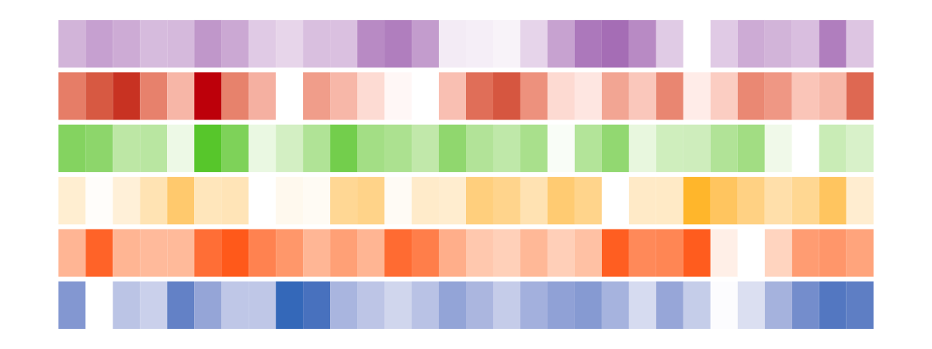
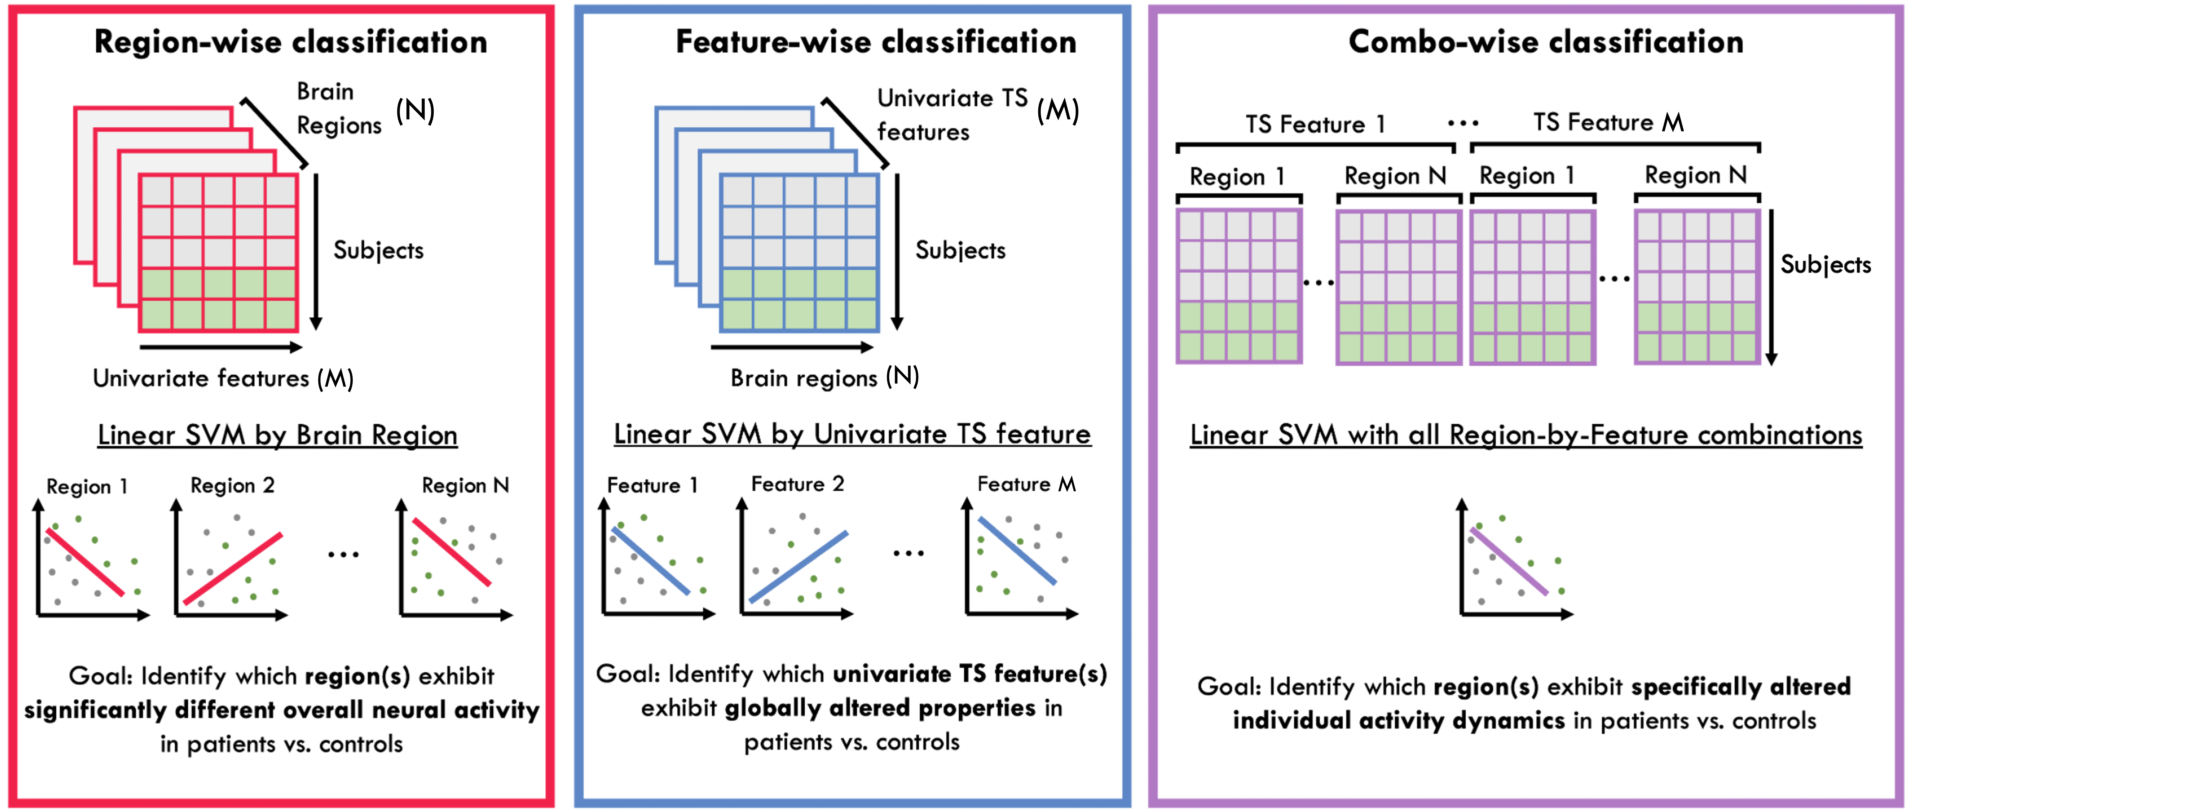

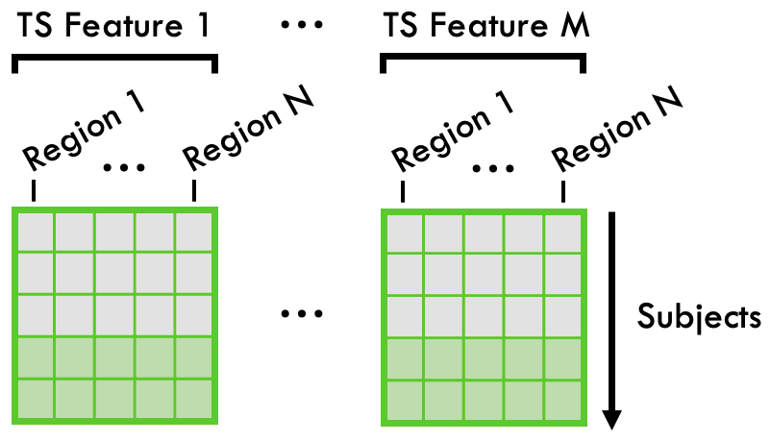


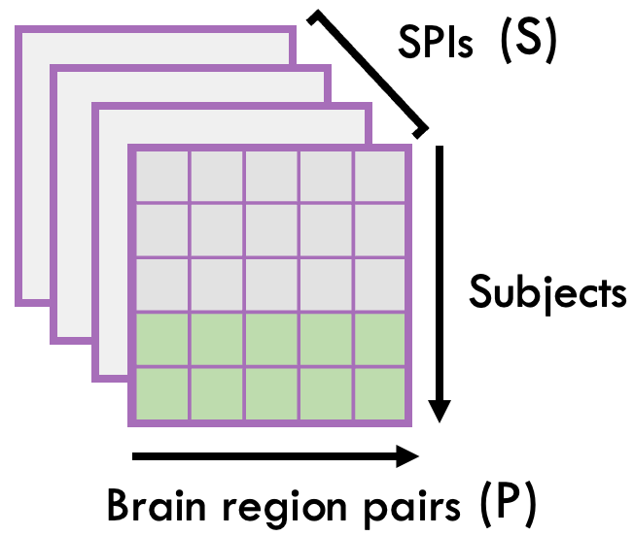



Figure 1
A
B
C
Region N
Measure BOLD fMRI temporal signals across brain regions
Extract univariate TS features from each brain region
Feature M
Combination
Controls
D
E
Patients
SPI S
Example Cohort
Extract pairwise TS features from each brain region pair
Notes:
Figure 1. Overview of study design and methodology. A: Representation of methods to extract univariate and pairwise time-series (TS) features from BOLD fMRI data, using theft (R) and pyspi (python), respectively. Each feature type yields a series of subject-by-feature matrices, partitioned by either brain region (univariate, upper row) or pair of brain regions (pairwise, lower row). B: Representation of the five different classification methods evaluated in this study. The upper row shows the three univariate schemes: region-wise (pink), feature-wise (blue), and combo-wise (purple; i.e. all region and feature info as input). The lower row shows the pairwise classification analysis (green) and combined univariate and pairwise (yellow) classification schemes.

